Slide 1
BioCalc
Through the dark waters of the javascript inheritance
Alexandru Iuga
Braşov, October 2013

Slide 2
Agenda
Introduction
Creating objects
Inheritance
Adapter Pattern

Slide 3
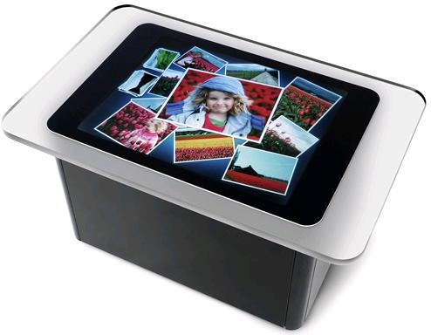
What is the Microsoft Surface?
  It’s a “big ass table” ☺
  http://www.youtube.com/watch?v=oHgwWMOGWYc
  It’s a computer that:
    Has a different look and feel
    Doesn’t have a keyboard or mouse*
    Uses a multi-touch display as a user interface
    Can recognize stuff placed on it
  *you can attach them though, because it’s still a PC

